Slide 1
Sin of ‘Breaking’ Amrit
Maryada directions are general guidelines.

Slide 2
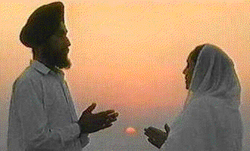
confidential question
“I live in northern Canada and I am in serious trouble.
I shall have to commit the sin of ‘breaking’ my amrit.
We were told to recite Rehras at sunset and get up three hours before sunrise to do our morning nitnem.
At the place, where I live, the sun sets after 10 pm and the sun rises much earlier than 5 am.
It is not possible for me to get up at 2 am when we sleep at 11 pm or so.
I shall have to sleep longer and my amrit will ‘break’. What can I do?”

Slide 3

. If we move further north we enter the polar zone, where there is 6-month day and 6-month night, technically one day in a year, because the sun rises and sets only once in a whole year.
At whatever latitude we may live, we generally divide our daily cycle in three sections, 8 hours for work, 8 hours for sleep, and 8 hours for routine chores with minor modifications according to the seasons and personal lifestyle.

Slide 4
Maryada directions are general guidelines.
“Maryada directions are general guidelines.
They mean that we recite our Rehras before our evening meals, and have a full night sleep.
We must wake up in the morning so that we have sufficient time for completing our nitnem before we take our breakfast and go to work.
Do not care at what time the sun rises or sets, you go on with your normal routine as directed by your watch.”

